Slide 1
Bookaneers Style Guide
Project Task List 3
Cheyenne Hunsley
Mbaye Fall

Slide 2
Colour Palette
Colour Hex:
293121
Colour Hex:
3B2916
Font/Border Default
Colour Hex:
1E140B
Colour Hex:
333D29
Colour Hex:
4A331C
Light Contrast
Colour Hex:
414833
Colour Hex:
684827
Colour Hex:
C2C5AA
Colour Hex:
656D4A
Colour Hex:
845C33
Colour Hex:
B6AD90
Colour Hex:
A4AC86
Colour Hex:
A68A64

Slide 3
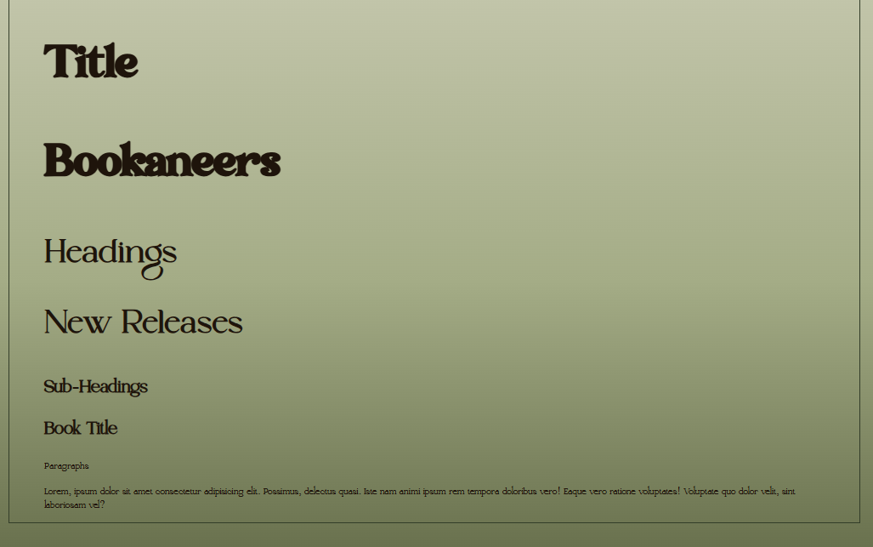
Fonts
Font Examples
Title Font – Transcity Regular
Headings – Kugile Regular
Default – Oliver Regular
Quotes – Oliver Italics

Slide 4






Icons + Buttons
Button 1
Button 2
Button 3
Button 4

